Slide 1
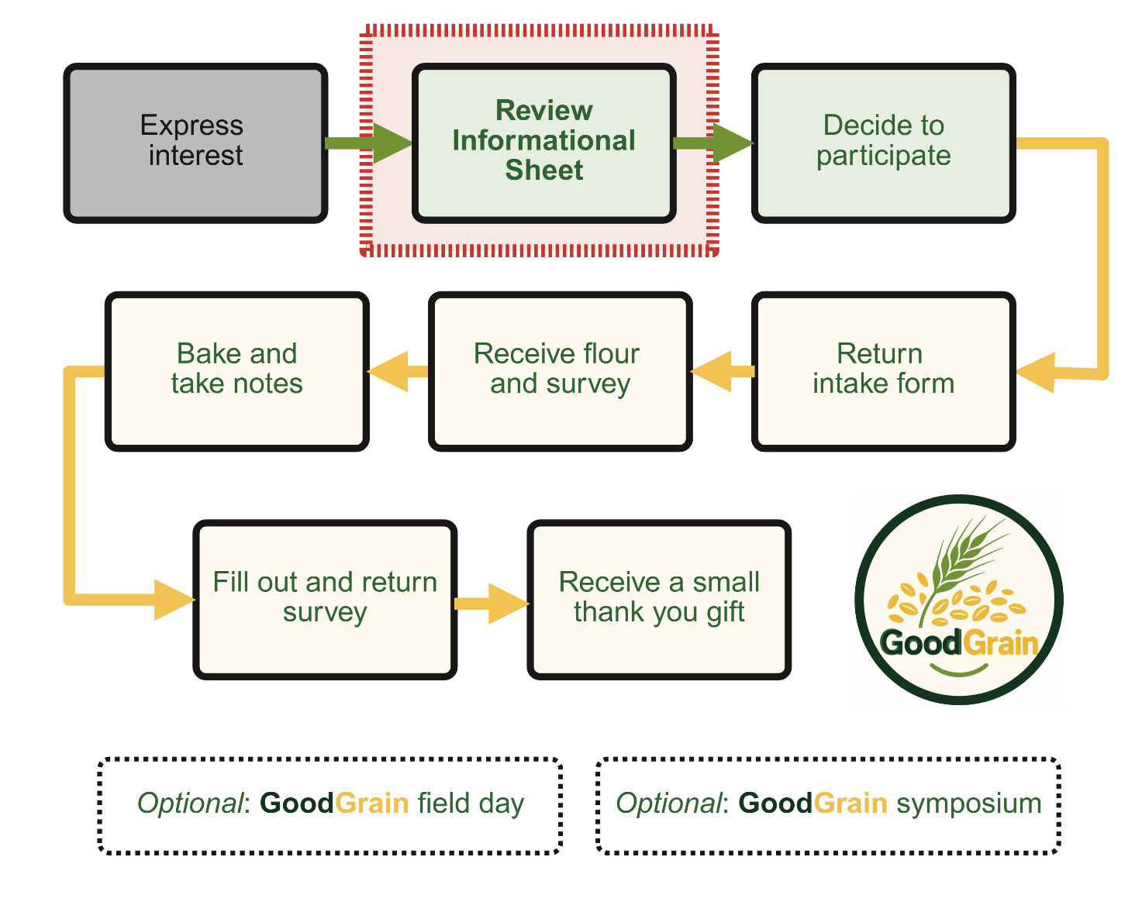
GoodGrain Home Baking Evaluation
Informational video
Virginia Anne Nichols & Claus Krogh Madsen
GoodGrain Home Baking Evaluation

Slide 2
Introduction
GoodGrain Home Baking Evaluation

Slide 3
Introduction
You have expressed interest in conducting a home baking evaluation using a new perennial variety of rye.
Thank you for your interest!
This presentation provides more in-depth information about the new variety so you can decide whether you would like to participate.
GoodGrain Home Baking Evaluation

Slide 4
What happens next?
Watch the Informational Video (in English) and/or read the Informational Sheet in English or Danish.
If you decide you would like to participate in the research, complete the intake form.
Attendance at the GoodGrain field event and symposium is optional and is not required for participation in the Home Baking Evaluation.
GoodGrain Home Baking Evaluation

Slide 5
Optional events
Summer 2027: Public event where you can see perennial rye growing in the field
Fall 2027: A public symposium to share information about perennial rye
Both are free and open to the public!
Attendance at the GoodGrain field event and symposium is optional and is not required for participation in the Home Baking Evaluation.
GoodGrain Home Baking Evaluation

Slide 6
An overview of the project
Common bread crops such as wheat, oats, rye and barley are annuals: they are sown, produce one grain harvest, and must then be sown again.
A crop producing two or three grain harvests from one sowing could save farmers work and tractor driving.
Remaining in the field and developing more roots may also create better environmental outcomes.
A few perennial grain varieties have recently been developed, including a perennial rye that is being tested in Denmark.
GoodGrain Home Baking Evaluation

Slide 7
Why GoodGrain?
Field testing is evaluating how the new perennial rye grows in Denmark and how it affects the environment compared with annual rye.
GoodGrain builds on this knowledge by looking specifically at the new perennial rye's grain characteristics.
One important characteristic is baking quality.
The project also wants to engage with communities in this research.
GoodGrain Home Baking Evaluation

Slide 8
What does participating involve?
You will receive approximately 1 kg of rye flour from the new perennial variety.
You will purchase any additional ingredients needed for your baking.
You will take notes during baking and use them to complete a follow-up survey.
After completing the survey, you will receive a small thank-you gift.
GoodGrain Home Baking Evaluation

Slide 9
GoodGrain events in 2027
Summer 2027: an event where you can see the perennial rye growing in a field test plot in Jutland.
Fall 2027: a public symposium in Copenhagen sharing current knowledge about perennial rye.
The symposium will bring together people across the value chain: researchers, breeders, farmers, millers, bakers and bread eaters.
Both events are free and open to the public, and attendance is optional.
GoodGrain Home Baking Evaluation

Slide 10
Funding and project partners
This citizen science project is part of an NNF Plant2Food research project (Grant #NNF22SA0081019).
Aarhus University: Department of Agroecology and Department of Food Science.
Wageningen University and Research, Netherlands.
Meyers, a Danish food enterprise.
More information: projects.au.dk/plant2food/funded-projects/goodgrain
GoodGrain Home Baking Evaluation

Slide 11
Is it safe to eat?
Yes.
The grain used to make the flour you will receive was tested at an independent laboratory to ensure it is safe for human consumption.
The laboratory results are available in the GoodGrain Lab Results PDF.
GoodGrain Home Baking Evaluation

Slide 12
Is the perennial rye genetically modified?
No.
This variety was developed using traditional breeding methods.
Plants were crossed by hand, followed by selection based on their physical characteristics.
The original QMD links to a scientific publication from 1986 for more information.
GoodGrain Home Baking Evaluation

Slide 13
Is this grain organic?
No.
Aarhus University does not have organically certified land because of the costs and additional administrative complexity.
However, this grain was grown without the use of pesticides.
GoodGrain Home Baking Evaluation

Slide 14
Can I buy this flour?
Flour from this perennial rye variety is not currently available commercially.
The project is laying the groundwork for a potential commercial release.
Your help with the home baking evaluation is appreciated!
GoodGrain Home Baking Evaluation

Slide 15
For the curious: perennial vs. annual
Perennial plants live for more than one year; annual plants do not.
Perennials are very common in nature: trees, shrubs and many grasses are examples.
Many kitchen-garden crops are annuals and must be replanted every year.
This pattern—perennials in nature, annuals in agriculture—is seen globally.
Many of the crops we use most, and plant on the most land, are annuals.
GoodGrain Home Baking Evaluation

Slide 16
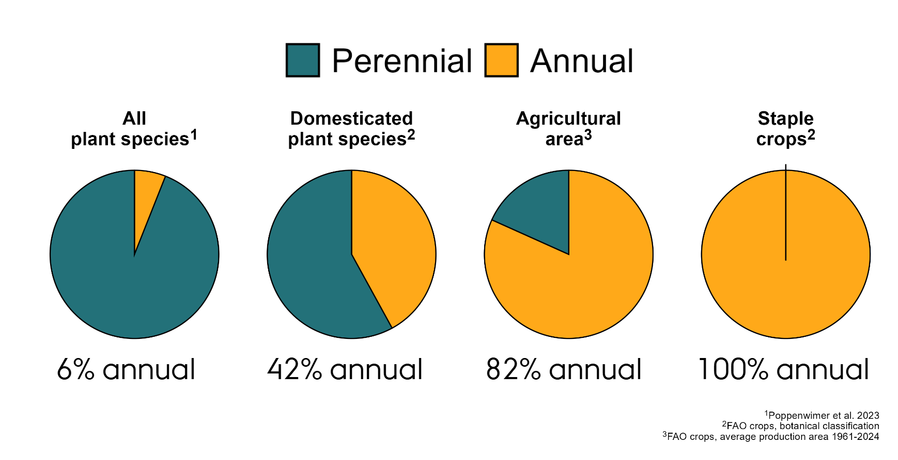

Slide 17
Why might perennial crops be useful?
It is not yet clear whether annual plants are inherently superior for food production or whether humans simply happened to domesticate them.
Having more perennials integrated into agricultural land would offer environmental benefits.
Perennials can help put carbon into the soil.
They provide soil cover year-round.
They can use resources such as water and nitrogen more efficiently.
Creating perennial versions of staple crops, such as rye, is one way to integrate more perennials into agriculture.
GoodGrain Home Baking Evaluation

Slide 18
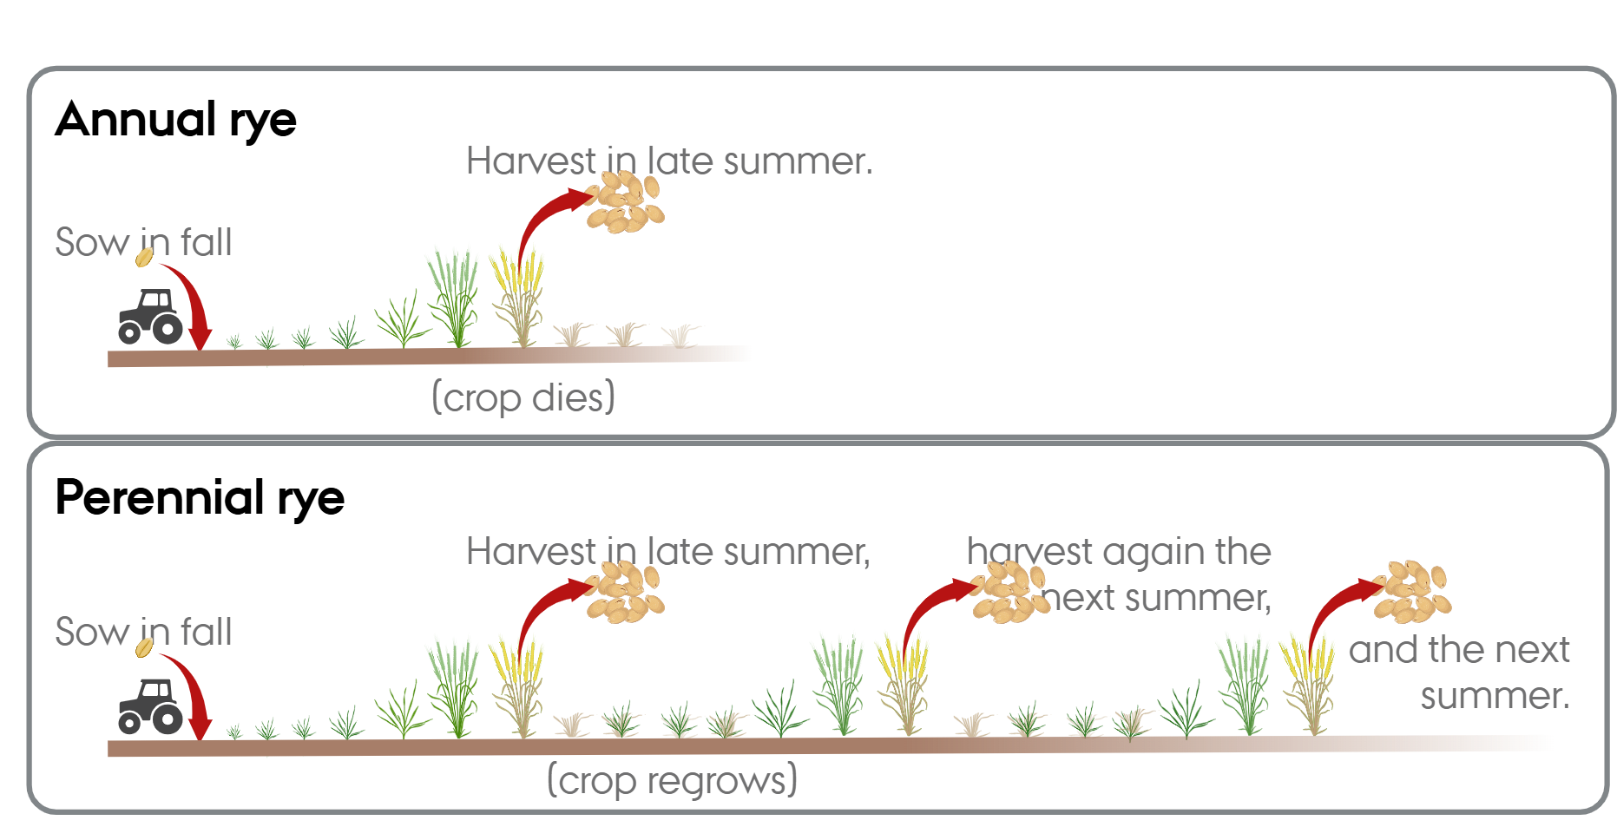
The history of this perennial rye
There have been efforts to breed perennial wheat since the 1930s.
At the University of Hohenheim in Germany, Dr. Reimann-Philips and his team crossed annual rye with an old perennial rye ancestor in the 1960s.
They tested the resulting plants and made further selections.
The resulting crop was perennial and, in the 1990s, was submitted for consideration as a variety in Germany.
GoodGrain Home Baking Evaluation

Slide 19
What happened to the crop?
The German government rejected the application, and the crop was never released as a variety.
The breeders maintained some plots as a passion project.
Some material was later released as a wildlife forage crop.
The perennial rye received little attention for about thirty years.
In 2023, Dr. Thomas Miedaner shared seeds with researchers at Aarhus University.
GoodGrain Home Baking Evaluation

Slide 20
Why are we interested now?
The researchers at Aarhus University think perennial rye has a lot of potential in Denmark.
In 2025, the perennial rye was tested side-by-side with a high-yielding annual rye.
It produced about half the grain yield of the modern annual rye.
The result was especially promising given that the perennial rye was crossed with varieties from the 1960s.
GoodGrain is part of the effort to develop and understand this variety.
GoodGrain Home Baking Evaluation

Slide 21
How long will the crop produce grain?
This has not yet been tested extensively.
The perennial rye appears to reliably produce grain for at least two years.
After that, weeds and diseases may become problems.
More research is needed to determine the optimal way to manage the crop.
GoodGrain Home Baking Evaluation

Slide 22
Thank you!
Thank you for considering participation in the GoodGrain Home Baking Evaluation.
Your baking experience will help us understand how this perennial rye performs in home kitchens and how people feel about eating a perennial grain.
GoodGrain project: projects.au.dk/plant2food/funded-projects/goodgrain
GoodGrain Home Baking Evaluation

